Slide 1

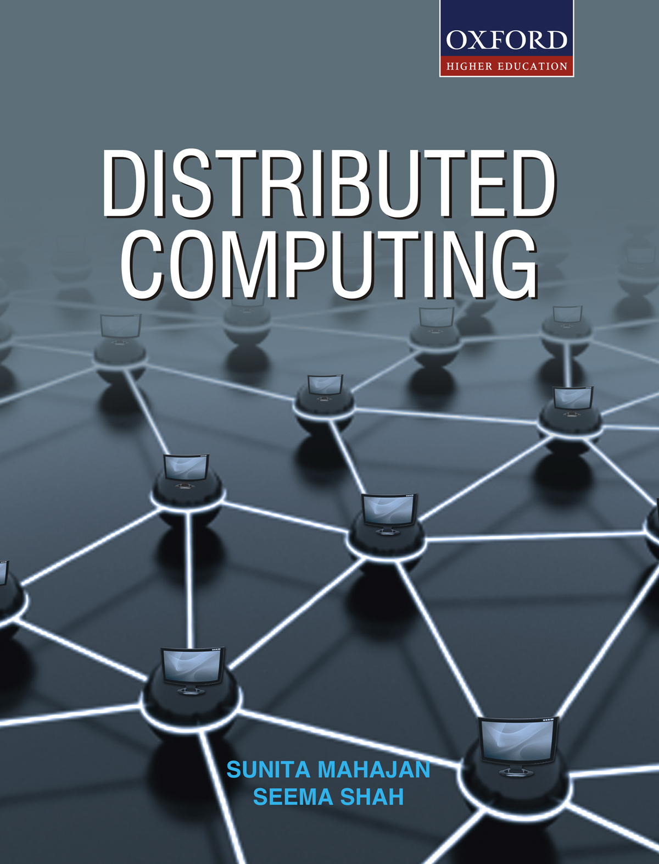
DISTRIBUTED COMPUTING
Sunita Mahajan, Principal, Institute of Computer Science, MET League of Colleges, Mumbai
Seema Shah, Principal, Vidyalankar Institute of Technology, Mumbai University

Slide 2
Chapter - 5
Synchronization

Slide 3
Topics
Introduction
Clock synchronization
Logical clocks
Global state
Mutual exclusion
Election algorithms
Deadlocks in distributed systems
Case study: Deadlock in message communication

Slide 4
Introduction

Slide 5
Concurrent processes
Cooperating processes
Competitive processes

Slide 6
Clock synchronization

Slide 7
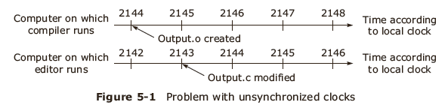
Physical clocks
Problems with un-synchronized clocks
Implementing computer clocks

Slide 8
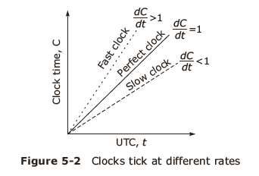
Drifting of computer clocks

Slide 9
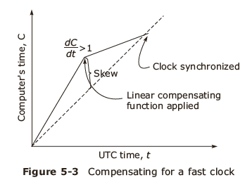
Synchronization using real time clocks
UTC
Mutual synchronization among clocks within the system

Slide 10
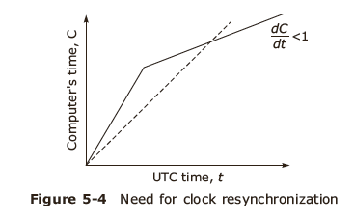
Issues in clock synchronization
Ability for each node to read the other node’s clock value
Time must never run backwards

Slide 11
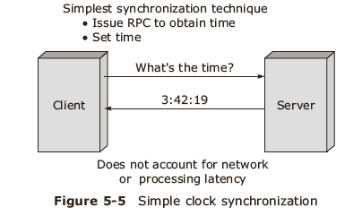
Simple Clock synchronization

Slide 12
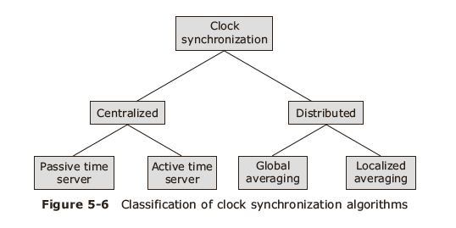
Clock synchronization

Slide 13
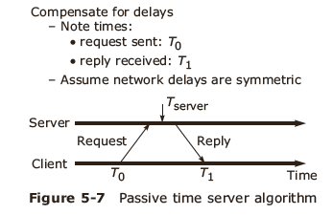
Centralized algorithms-1
Passive time server

Slide 14
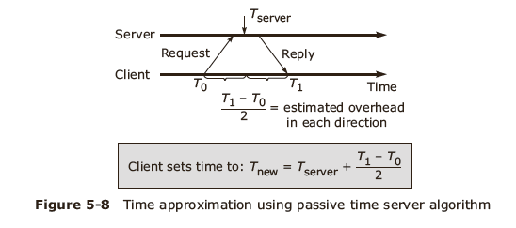
Centralized algorithm-2

Slide 15
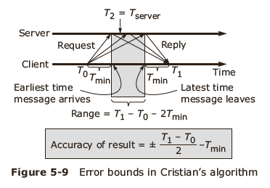
Centralized algorithm-3
Cristian’s method

Slide 16
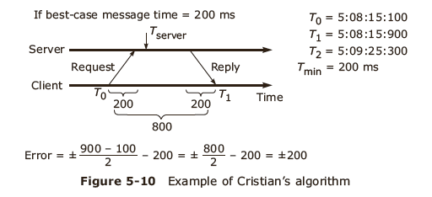
Centralized algorithm-4

Slide 17
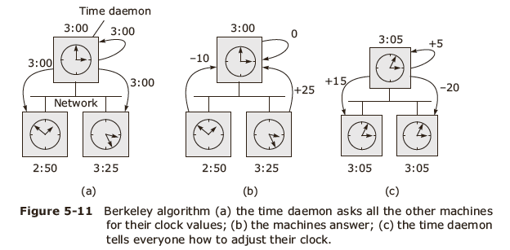
Active time server centralized algorithm
Berkeley algorithm

Slide 18
Distributed algorithms
Characteristics
  Relevant information is distributed across machines
  Processes make decisions based only on local information
  Single points of failure must be avoided
  No common or global clock is available
Global averaging distributed algorithm
Localized averaging distributed algorithm

Slide 19
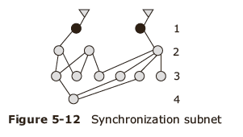
Network time Protocol
Synchronization Modes
  Multicast mode
  Procedural call mode
  Symmetric mode

Slide 20
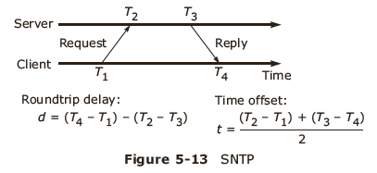
Simple Network Time Protocol-1

Slide 21
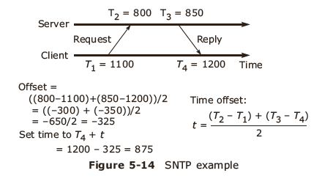
Simple Network Time Protocol-2

Slide 22
Use of synchronized clocks
At-most-once message delivery semantics
Clock-based file system cache consistency

Slide 23
Logical clocks

Slide 24
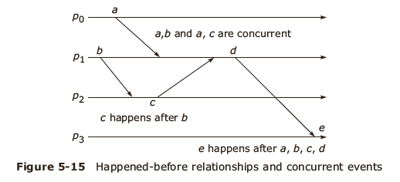
Event ordering
Happened before relation
Causal ordering

Slide 25
Lamport’s idea of logical clocks
Processes that don't interact don't matter (need a common clock)
Event ordering is key, rather than true time
Absolute correctness is less important than consistency (logical versus physical clocks)

Slide 26
Implementation of Logical Clocks
Conditions for correct functioning:
C1: If a and b are two events in the same process, and a→ b, then we demand that C(a) < C(b).
C2: If a corresponds to sending a message m, and b corresponds to receiving that message, then also C(a) < C(b).
C3: A clock C associated with the process P must always go forward, never backwards. Hence corrections to a logical clock must be always made by adding a positive value , never subtracting from it.

Slide 27
Lamport’s Implementation Rules
IR1:
  Each process P increments C by any two successive events. This IR ensures that condition C1 is satisfied.
IR2:
  If event a is sending of a message m by process P, the message m contains a timestamp Tm- C(a) and upon receiving the message m by another process P, it sets its clock C to a value greater or equal to its present value but greater than Tm. This IR ensures that condition C2 is met.

Slide 28
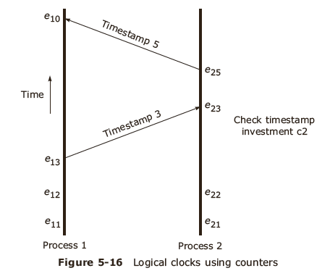
Implementation using Counters
(change e10 to e110 –use figure in second print edition.)
e110

Slide 29
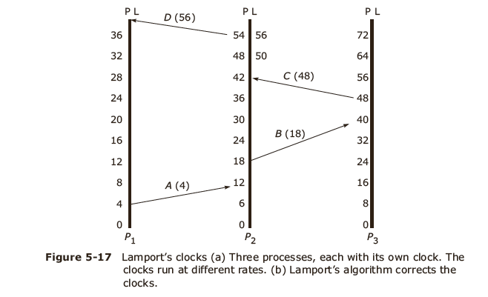
Lamport’s Timestamps

Slide 30
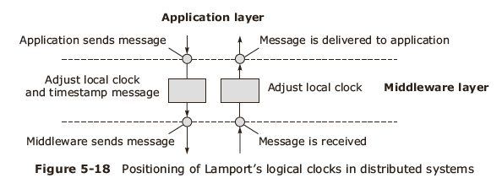
Position of logical clocks in Middleware

Slide 31
Total ordering of events
Conditions for assigning time:
  If a happens before b in the same process P, then C(a)< C(b)
  If a and b represent the sending and receiving of a message, then C(a)< C(b)
  For all distinct events a and b, C(a) not = C(b)

Slide 32
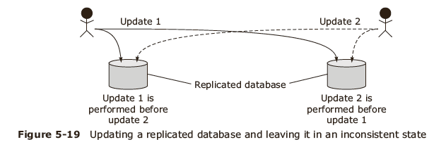
Totally Ordered Multicasting

Slide 33
Vector Timestamps-1
Causality is captured by Vector timestamps
Vector properties
  VCi [ i ] is the number of events that have occurred so far at Pi.
  If VCi [ j ] = k then Pi knows that k events have occurred at Pj.

Slide 34
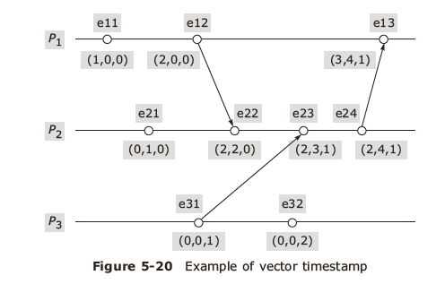
Vector Timestamps-2

Slide 35
Global State

Slide 36
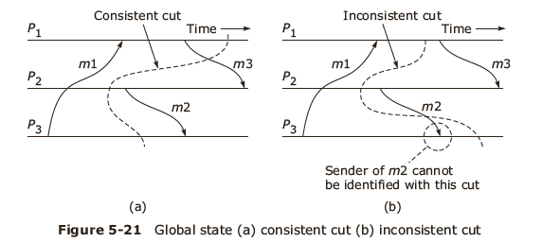
Recording global state
By Chandy and Lamport
Recording global state ( current state )
Termination detection

Slide 37
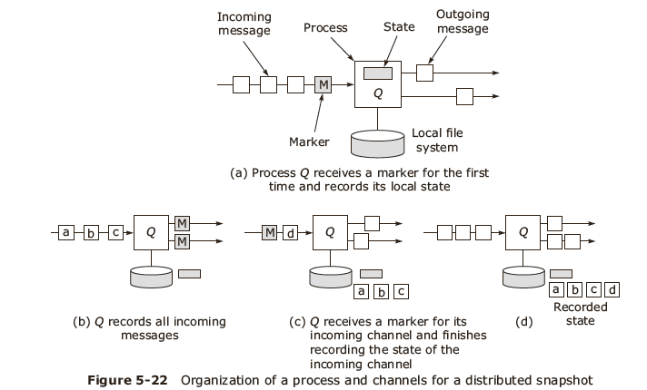
Distributed snapshot

Slide 38
Mutual exclusion

Slide 39
Mutual exclusion algorithms
Centralized Algorithm
Distributed Algorithm
Token Ring Algorithm

Slide 40
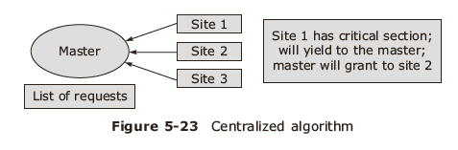
Centralized mutual exclusion algorithm
Messages used:
  Request-R
  Grant-G
  Release-R.

Slide 41
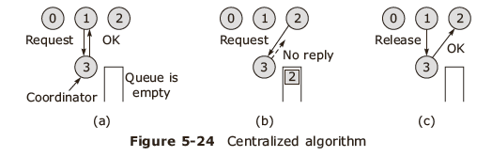
Centralized algorithm execution

Slide 42
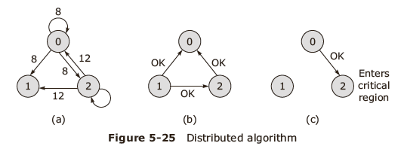
Distributed algorithm execution

Slide 43
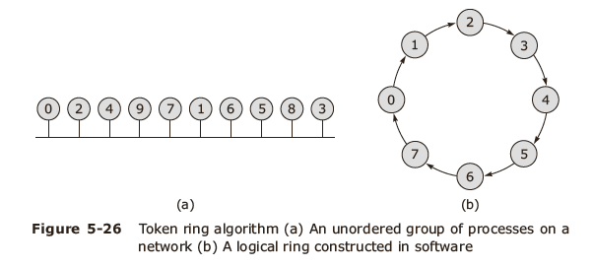
Token Ring algorithm execution

Slide 44
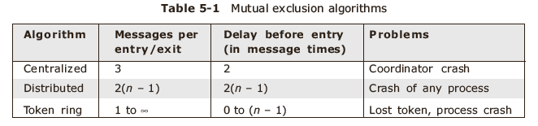
Comparison

Slide 45
Election algorithms

Slide 46
Introduction
Goals
  Attempt to locate the process with the highest process number and designate it as the coordinator and tell all the active processes about this coordinator.
  To allow a recovered leader to re-establish control (or at least, to identify the current leader).
Algorithms
  Bully algorithm
  Ring algorithm

Slide 47
The Bully algorithm
Messages
  Election (E)—announce an election
  Reply (R) — acknowledge election msg.
  Coordinator ( C) — announce new coordinator

Slide 48
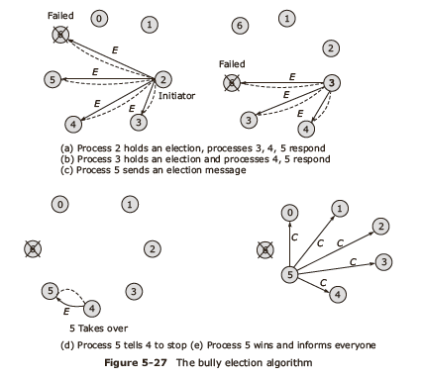
Bully algorithm - example
0

Slide 49
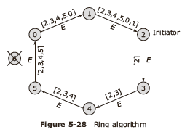
Token Ring algorithm
Messages
  Election (E)—announce an election, is token message
  Coordinator ( C) — announce new coordinator

Slide 50
Comparison
Bully algorithm
N–2 messages in best case
O(N²) messages in worst case
Ring algorithm
3N–1 messages in worst case
N–1 election messages to reach immediate neighbour in wrong direction, N election messages to elect it, then N elected messages to announce result

Slide 51
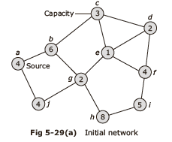
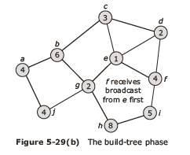
Election in a Wireless Network-1

Slide 52
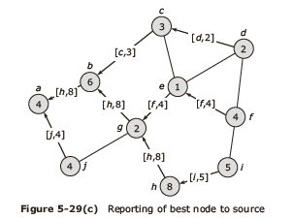
Election in a Wireless Network-2

Slide 53
Deadlocks in distributed systems

Slide 54
Basic concepts
Resources:
  Preemptable resources
  Nonpreemptable resources
Sequence of events: request, allocate and release
Request →Allocate →Use →Release

Slide 55
Distributed Deadlocks
Types:
  Communication deadlocks
  Resource deadlocks
Necessary and sufficient conditions for deadlock to occur:
  Mutual exclusion condition
  Hold and wait condition
  No preemption condition
  Circular wait condition

Slide 56
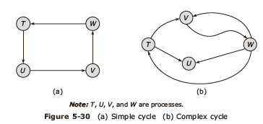
Concept of Cycle

Slide 57
Deadlock modelling
Basic terminologies
  Directed graphs
  Path
  Cycle
  Reachable set
  Knot

Slide 58
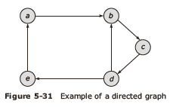
Directed graph-1
Also called a Resource Allocation Graph (RAG)
  Nodes
  Edges

Slide 59
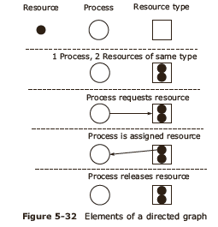
Directed graph-2

Slide 60
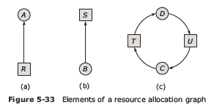
Elements of RAG
Process node
Resource node
Assignment edge
Request edge

Slide 61
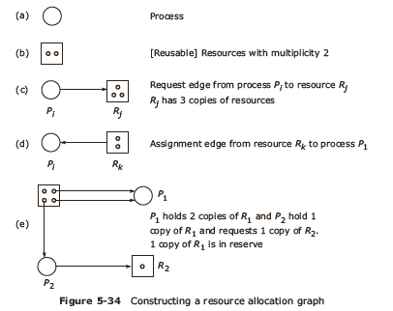
RAG
R1

Slide 62
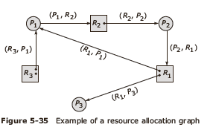
RAG example

Slide 63
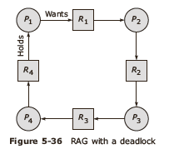
State transition rules
Request
Acquisition
Release

Slide 64
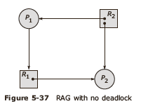
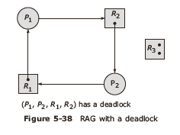
Necessary and sufficient conditions in RAG

Slide 65
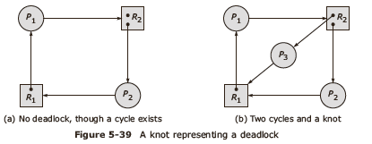
Knot in RAG

Slide 66
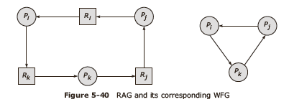
Wait For Graph : WFG-1

Slide 67
Wait For Graph : WFG-2
If graph contains no cycles ⇒ no deadlock.
If graph contains a cycle ⇒
  if only one instance per resource type, then deadlock.
  if several instances per resource type, possibility of deadlock.

Slide 68
Handling deadlock in distributed systems
The ostrich algorithm (ignore the problem, most common approach)
Avoidance (avoid deadlocks by allocating resources carefully)
Prevention (make deadlocks structurally impossible)
Detection (let deadlocks occur, detect them, and then try to recover)

Slide 69
Notion of safety
Deadlock:
  No forward progress can be made.
Unsafe state:
  A state which does not have a safe sequence and that may allow a deadlock to occur.
Safe state:
  A state is safe if it is not in a deadlock state, and if a sequence of processes exist such that there are enough resources for the first process to finish, and as each process finishes and releases its resources there are enough for the next process to finish.
Safe sequence:
  For a particular safe state, there can be many process orderings. Any ordering of the processes which can guarantee the completion of all processes is called a safe sequence.

Slide 70
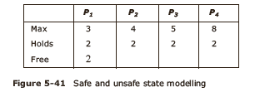
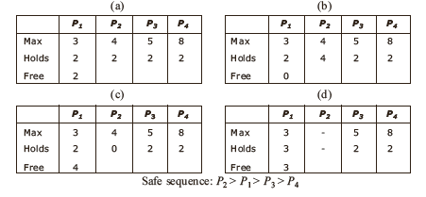
Deadlock avoidance-1

Slide 71
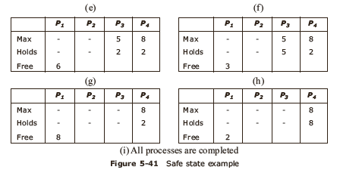
Deadlock avoidance-2

Slide 72
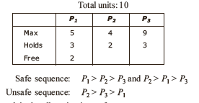
Another example of resource allocation

Slide 73
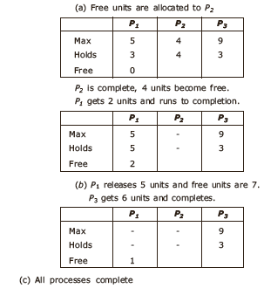
Safe allocation

Slide 74
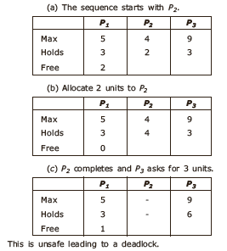
Unsafe allocation

Slide 75
Distributed deadlock prevention
Collective requests (denies the hold and wait condition)
Ordered requests (denies the circular wait condition)
Preemption (denies the no preemption condition)

Slide 76
Schemes for killing transactions
Wait-die
Wound-wait

Slide 77

Wait-die
  If an old process wants a resource held by a young process, the old one will wait.
  If a young process wants a resource held by an old process, the young process will be killed.

Slide 78

Wound-wait
  If an old process wants a resource held by a young process, the old one will preempt the young process -- wounded and killed, restarts and wait.
  If a young process wants a resource held by an old process, the young process will wait.

Slide 79

Distributed deadlock detection-1
Features
Correctness in terms of progress and safety

Slide 80

Distributed deadlock detection-2

Slide 81
Deadlock detection techniques
Centralized control
Hierarchical control
Distributed control

Slide 82
Centralized control
Local deadlock
Global WFG
Message transfer:
  Continuous transfer
  Periodic transfer
  Transfer on request

Slide 83

False Deadlock

Slide 84

Hierarchical control-1

Slide 85

Hierarchical control-2

Slide 86

Hierarchical control-3

Slide 87

Hierarchical control-4

Slide 88
Distributed deadlock detection
WFG based distributed approach
Probe based distributed algorithm

Slide 89

WFG based distributed approach-1

Slide 90

WFG based distributed approach-2

Slide 91

Probe based distributed algorithm
The Chandy-Misra-Haas algorithm

Slide 92
Distributed deadlock recovery
Recovery through preemption
Recovery through rollback
Recovery through killing processes

Slide 93
Issues in recovery from deadlock
Selection of victims
Minimization of recovery costs
Prevention of starvation
Use of transaction mechanism

Slide 94
Case study:
Deadlock in message communication

Slide 95


Mutual waiting condition

Slide 96
Summary
Introduction
Clock synchronization
Logical clocks
Global state
Mutual exclusion
Election algorithms
Deadlocks in distributed systems
Case study: Deadlock in message communication

